Slide 1

SYRIA-TEL CUSTOMER CHURN
BEDAN KIBUNJA CHEGE
DSFT 09
MORINGA SCHOOL

Slide 2
BUSINESS UNDERSTANDING
PROJECT OVERVIEW: CUSTOMER CHURN PREDICTION FOR SYRIA-TEL
OBJECTIVE: DEVELOP A PREDICTIVE MODEL TO IDENTIFY CUSTOMERS LIKELY TO CHURN.
IMPORTANCE:
  RETAINING CUSTOMERS IS MORE COST-EFFECTIVE THAN ACQUIRING NEW ONES.
  REDUCING CHURN CAN LOWER REVENUE LOSS AND BOOST CUSTOMER SATISFACTION.
GOAL:
  BUILD A BINARY CLASSIFICATION MODEL TO PREDICT CUSTOMER CHURN.
  ANALYZE CUSTOMER DATA TO UNCOVER INSIGHTS AND REDUCE CHURN IMPACT.
Notes:
The project aims to build a predictive model to identify customers who are likely to churn (stop doing business) from SyriaTel, a telecommunications company. Churn prediction is crucial for the company because retaining existing customers is often more cost-effective than acquiring new ones. By predicting churn, the company can proactively take steps to retain customers, thereby reducing revenue loss and improving customer satisfaction.

Slide 3
DATA UNDERSTANDING
DATA CHARACTERISTICS:
NUMERICAL FEATURES: REPRESENT CUSTOMER USAGE AND INTERACTIONS; CRITICAL FOR CHURN PATTERN IDENTIFICATION.
CATEGORICAL FEATURES: INCLUDES STATE, INTERNATIONAL PLAN, VOICE MAIL PLAN; USEFUL FOR CHURN INSIGHTS.
CLASS IMBALANCE: CHURN IS LESS FREQUENT THAN NON-CHURN; NEEDS ADDRESSING TO PREVENT BIASED PREDICTIONS.
PREPROCESSING CONSIDERATIONS:
MULTICOLLINEARITY: REMOVED FEATURES TO ENSURE INDEPENDENT CONTRIBUTIONS.
FEATURE ENGINEERING: ADDITIONAL FEATURES OR TRANSFORMATIONS MAY BE REQUIRED.
NORMALIZATION & SCALING: APPLIED TO BALANCE FEATURE CONTRIBUTIONS.
Notes:
Numerical Features: The dataset contains various numerical features representing customer usage and service interactions, which are crucial in identifying patterns related to churn. Categorical Features: Features like state, international_plan, and voice_mail_plan are categorical and may provide insights when analyzed for churn patterns
Multicollinearity: Some features were removed earlier due to multicollinearity, ensuring that the remaining features contribute independently to the model. Feature Engineering: New features or transformations might be needed to enhance the model’s predictive power. Normalization and Scaling: Given the range of values across different features, normalization and scaling are applied to ensure that all features contribute equally to the model. This data understanding forms the foundation for building an effective model, helping to identify which features are most influential in predicting customer churn and guiding the preprocessing steps to prepare the data for modeling.

Slide 4
DATA CLEANING & PREPARATION
  NO MISSING VALUES: COMPLETE DATASET WITH NO MISSING ENTRIES.
  Area code Column: Only three distinct area codes observed across 51 states. Indicates potential data reliability issues. Decision: Drop area code from analysis.
  Phone number Column: Does not contribute to churn prediction. Decision: Remove from analysis.
  Perfect Correlations Identified: Between total_x_minutes and total_x_charge (e.g., total_day_minutes with total_day_charge).
  Action: Drop total_x_minutes columns to address multicollinearity. Retain total_x_charge columns to avoid redundancy.
Notes:
The heatmap identifies perfect correlations (value of 1.00) between several pairs of features: total_day_minutes and total_day_charge, total_eve_minutes and total_eve_charge, total_night_minutes and total_night_charge, as well as total_intl_minutes and total_intl_charge. This is expected since charges are typically calculated based on the number of minutes spent on calls. However, this introduces multicollinearity into our model, which can distort the impact of individual variables and lead to overfitting. To mitigate this, we will drop the total_x_minutes columns (total_day_minutes, total_eve_minutes, total_night_minutes, and total_intl_minutes) from our dataset. Retaining only the corresponding total_x_charge columns should provide the same information without redundancy.

Slide 5
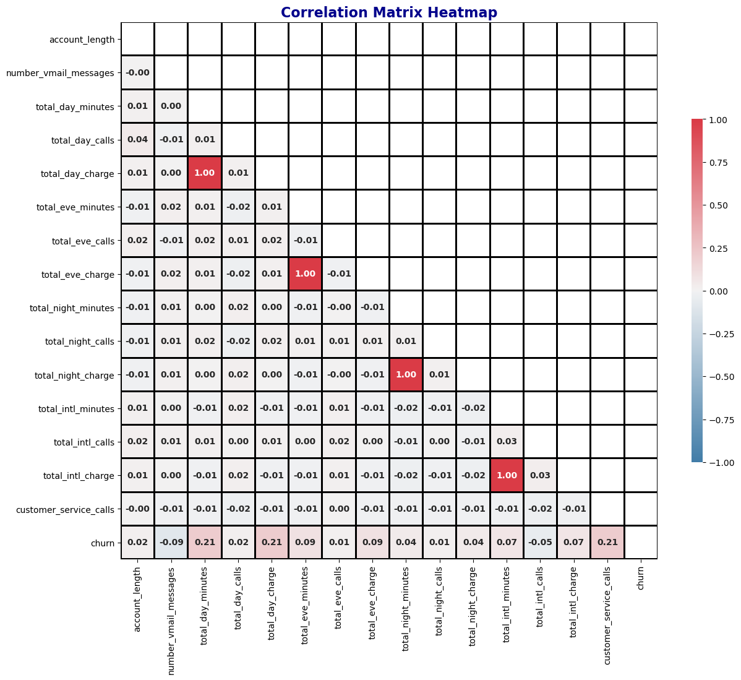
Notes:
Correlation with churn heatmap

Slide 6
DATA ANALYSIS
MODEL EVALUATION: WE TESTED MULTIPLE MODELS TO DETERMINE WHICH WOULD BEST FIT OUR DATA:
LOGISTIC REGRESSION: SERVED AS OUR BASELINE MODEL. WE TRAINED IT ON THE TRAINING DATA AND ASSESSED ITS PERFORMANCE.
DECISION TREE: WE EXPLORED THIS MODEL WHILE ADDRESSING OVERFITTING CONCERNS BY TUNING ITS HYPERPARAMETERS.
XGBOOST: AS A MORE ADVANCED MODEL, XGBOOST WAS EVALUATED FOR ITS PERFORMANCE AND ABILITY TO HANDLE THE DATASET'S COMPLEXITY. THE GOAL WAS TO IDENTIFY THE MODEL THAT OFFERED THE BEST PERFORMANCE METRICS, SUCH AS ACCURACY, RECALL, AND PRECISION, AND WAS WELL-SUITED FOR PREDICTING CUSTOMER CHURN.

Slide 7
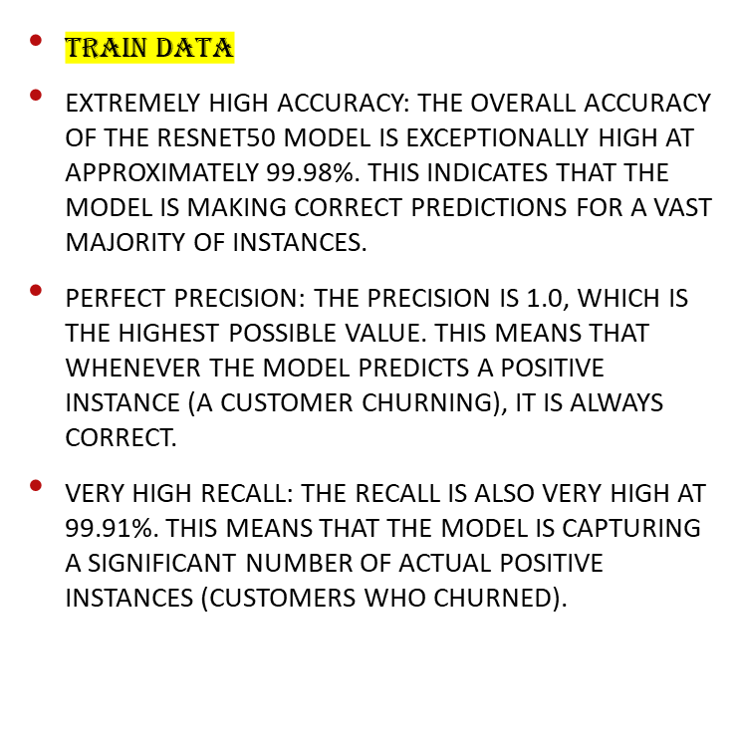
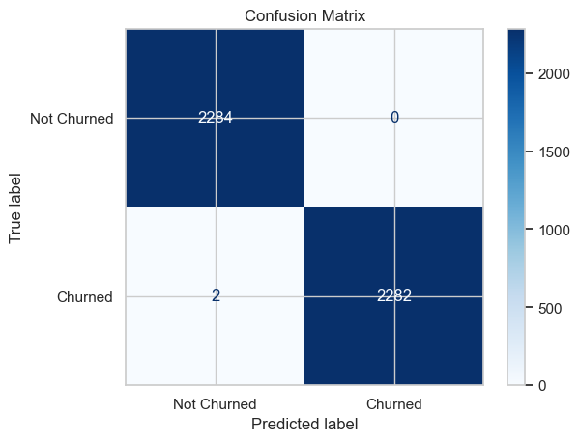
XGBOOST

Slide 8
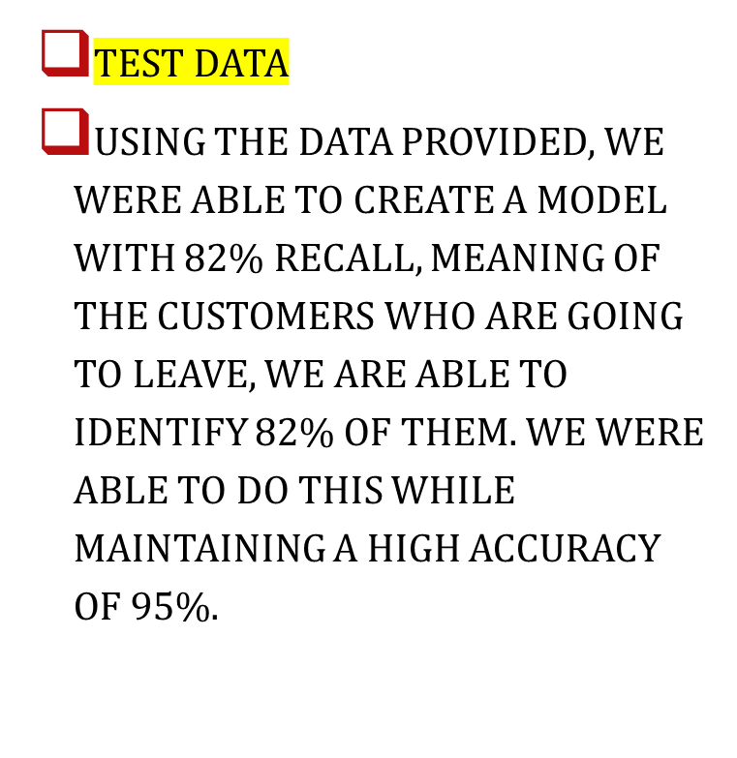
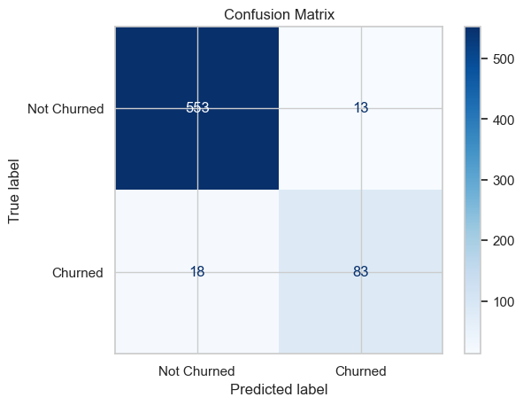
XGBOOST
Notes:
A precision and recall of 85% and 82% which is an impressive performance . Extremely High Accuracy: The overall accuracy is exceptionally high on the test data at approximately 95%

Slide 9
RECOMMENDATION
IT'S EVIDENT THAT MANY STATES APPEAR IN THE TOP 20 MOST IMPORTANT FEATURES. BASED ON THESE INSIGHTS, WE RECOMMEND THE FOLLOWING ACTIONS:
INVESTIGATE THE NEEDS OF INTERNATIONAL PLAN CUSTOMERS: CONSIDER WHETHER THERE'S A SHIFT TOWARD ONLINE COMMUNICATION TOOLS FOR INTERNATIONAL USERS, SUCH AS SKYPE, DISCORD, GOOGLE CHAT, OR FACETIME. EXPLORE THE POSSIBILITY OF OFFERING MORE ROBUST DATA PLANS TO ACCOMMODATE THIS TREND.
AUDIT CUSTOMER SERVICE CALLS: ENSURE THAT CUSTOMERS ARE RECEIVING ADEQUATE SUPPORT. IF THE MODEL IDENTIFIES A CUSTOMER AT RISK OF CHURNING, IT MIGHT BE BENEFICIAL TO REVIEW THEIR RECENT INTERACTIONS WITH CUSTOMER SERVICE TO ADDRESS ANY UNRESOLVED ISSUES.
REVIEW RATE COMPETITIVENESS: GIVEN THAT TOTAL DAY CHARGES ARE A SIGNIFICANT FACTOR IN OUR MODEL, IT’S IMPORTANT TO VERIFY THAT PRICING IS COMPETITIVE, PARTICULARLY IN STATES WITH HIGHER CHURN RATES.

